Slide 1
Dennard Scaling
Why the future will be different

Slide 2
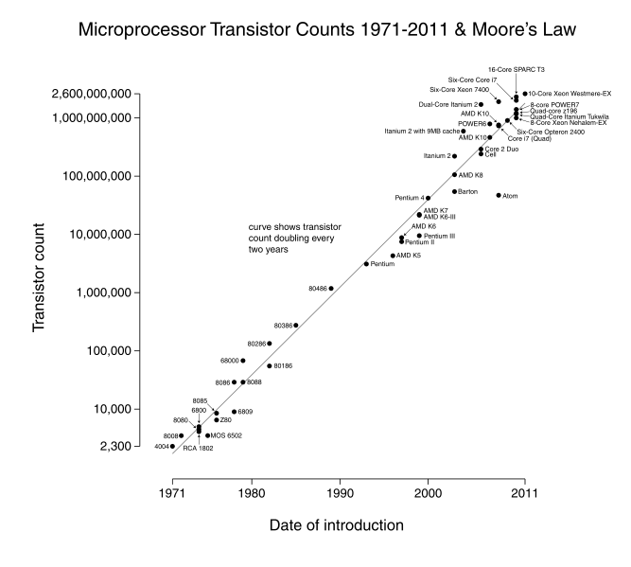

Slide 3
What does Moore’s law really say?
In 1965 Gordon Moore wrote an article for Electronics Magazine
He was asked to predict the next ten years of semiconductor development
Stated that the number of transistors would double each year.
Revised in 1975 to double every two years.
Moore didn’t know exactly why this was the case
He was viewing historical trends
In fact, shrinking dimensions on an integrated
structure makes it possible to operate the structure at
higher speed for the same power per unit area.

Slide 4
The reason Moore’s law works
In 1974, Robert Dennard and his team explained the trend Moore witnessed
Dennard Scaling
All important factors in transistor design scale down by the same constant
As they scale down, the electric field in the channel remains constant
Making transistors smaller made them better
Transistor density increased
Transistor switching delay decreased
Transistor power usage decreased
Source: Rob Rutenbar

Slide 5
Dennard Scaling
V
Gate
α =1/κ
αV
Gate
Oxide
Tox
Oxide
αTox
Source
Drain
Source
Drain
L
αL
Device or Circuit Parameter | Scaling Factor
Device Dimension Tox, L, W | 1/κ
Voltage | 1/κ
Current | 1/κ
Capacitance | 1/κ
Delay time | 1/κ
Power Dissipation | 1/κ²

